Slide 1



Uncertainty Aware Semi-Supervised Learning on Graph Data
Xujiang Zhao¹, Feng Chen¹, Shu Hu², Jin-Hee Cho³
¹The University of Texas at Dallas, ²University at Buffalo, SUNY, ³Virginia Tech
Notes:
Hello, my name is Xujiang, I am going to present our paper: …

Slide 2
Types of uncertainty
1
Epistemic uncertainty (a.k.a. model/parameter uncertainty)
Measures what model doesn’t know
Due to limited data and knowledge
Aleatoric uncertainty (a.k.a. data uncertainty)
Measures what you can’t understand from the data
Due to randomness
Probabilistic
Uncertainty
2
Vacuity uncertainty (a.k.a. ignorance)
Measures uncertainty due to a lack of evidence
Dissonance uncertainty
Measures uncertainty due to conflicting evidence
Evidential Uncertainty
[1] Alex Kendall and Yarin Gal. What Uncertainties Do We Need in Bayesian Deep Learning for Computer Vision? NIPS 2017.
[2] Audun Jøsang, Jin-Hee Cho, and Feng Chen. Uncertainty Characteristics of Subjective Opinions. FUSION 2018.
Notes:
Epistemic uncertainty due to limited data and aleatoric due to randomness. #####
And our paper paper will focus on the evidential uncertainty, vacuity and dissonance.

Slide 3
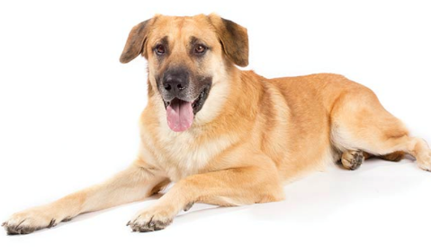

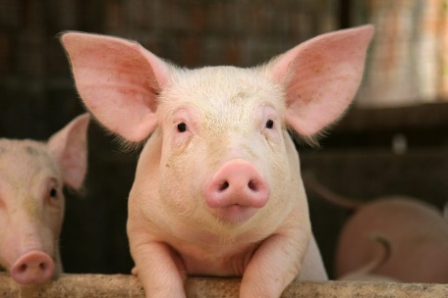
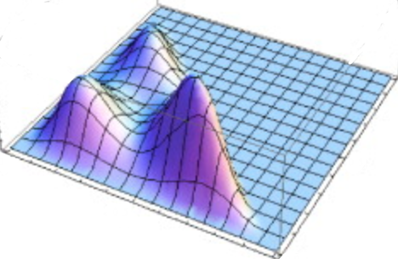

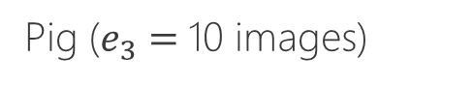
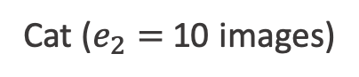
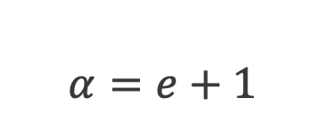
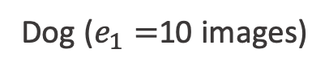
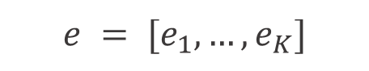
Evidential Uncertainty
Task: 3 class image classification
Training Data:
Dog ($e_{1}=$10 images)
Cat ($e_{2}=$10 images)
Pig ($e_{3}=$10 images)
$$e = [e_{1},…, e_{K}]$$
Evidence
(Historical observations)
$$α=e+1$$
Subjective Opinion
Dirichlet ($α$)
A subjective opinion modeled based on `Subjective Logic’ which uses Dirichlet distribution to measure multiple dimensions of uncertainty in classification tasks
Notes:
Here, I will introduce the evidence uncertainty by a simple image classification task, our training data only contains 3 class, dog, cat, pig, each class have 10 images. #####
Then we can get subjective opinion based on evidence. ####
And this opinion is equivalent to the Dirichlet distribution, #####
alpha is the Dirichlet distribution parameter, Then we can use subjective opinion and Dirichlet distribution to model evidence uncertainty.

Slide 4


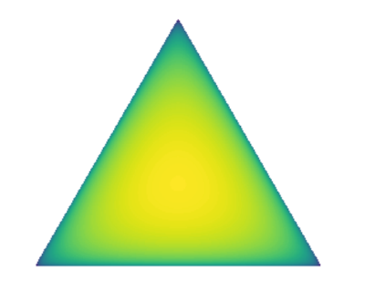
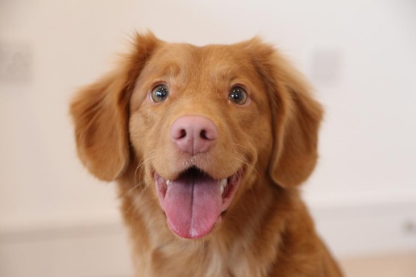
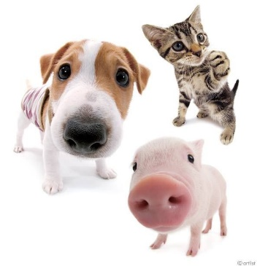
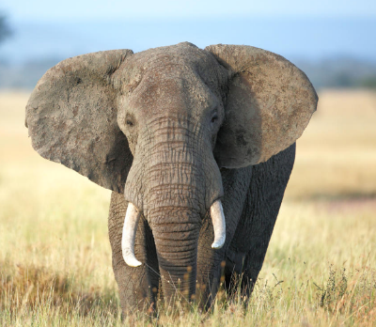
Why Evidential Uncertainty?
Confidence Prediction
Conflict Prediction
Out-of-Distribution
Different Vacuity
Dirichlet Distribution
α = [11, 1, 1]
α = [11, 11, 11]
α = [1, 1, 1]
Expected Probability
p = [0.83, 0.083, 0.083]
p = [1/3, 1/3, 1/3]
p = [1/3, 1/3, 1/3]
High Dissonance
(conflicting evidence)
High Vacuity
(lack of evidence)
Low Uncertainty
Sample
probability
Test image
Notes:
Why evidential uncertainty is better?
For example #####
Test a dog image: it eas and correct prediction with low uncertainty ###
Test with all dog, cat, and pig together: prediction with 1/3 equal paobability; each category supports with an equal amount of evidence. ###
Test with an elephant (out-of-distribution sample, our model never see before); it is lack of evidence, high vacuity with Dirichlet distribution being a uniform distribution.####
The probability can not distigush the CP AND OOD but evidential uncertaty can do it.

Slide 5
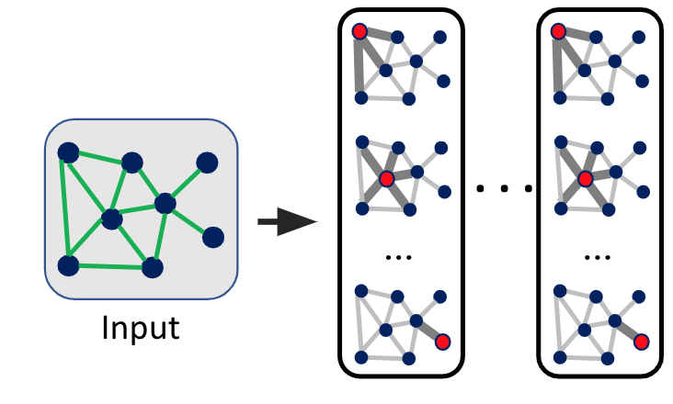
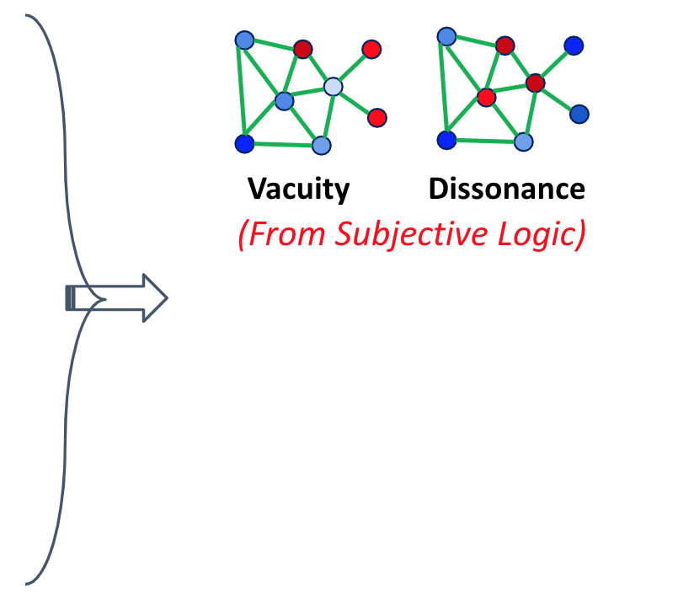
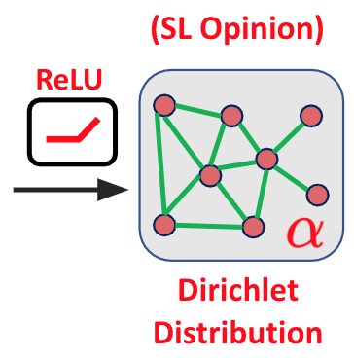
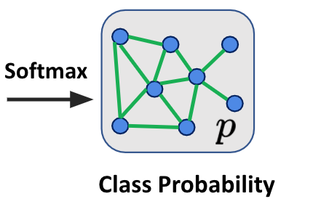
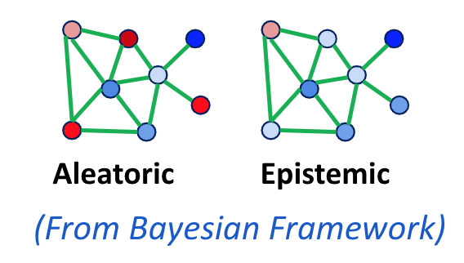
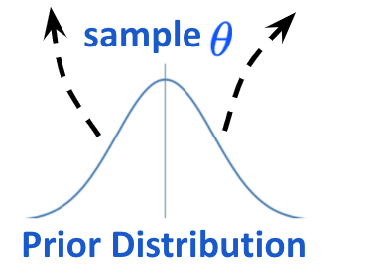
Uncertainty Aware Framework
GNN
Subjective GNN
Subjective Bayesian GNN
Multiple Uncertainties
Notes:
Here we introduce our proposed uncertainty framework. For semi-supervised node classification.
Here is the original GNN model, the output is class probability by softmax, #####
we simply change the activation f unction to a relu or others then we can change the output is the parameters of Dirichlet distribution. #####
Based on this Dirichlet distribution or SL opinion, we can estimate the vacuity and dissonance, we call this model is Subjective GNN. #####
And simply adapt Bayesian framework, we can get the aleatoric and epistemic uncertainty.

Slide 6
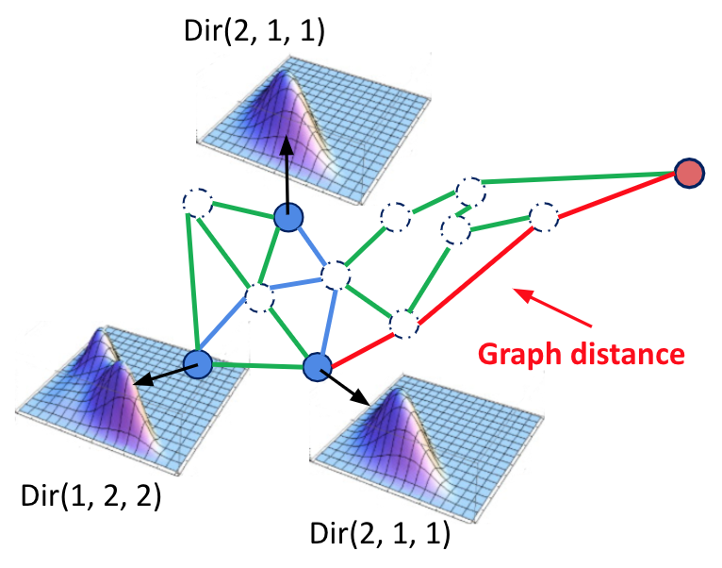
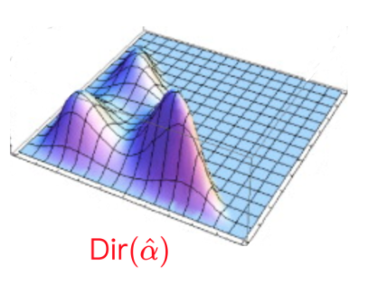
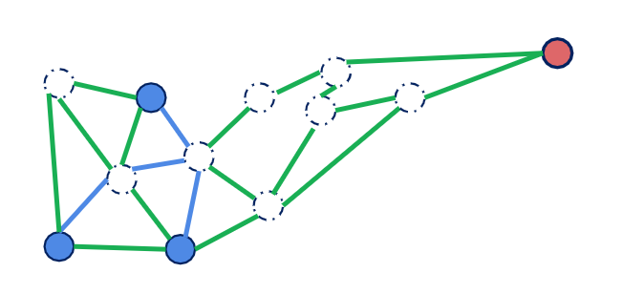
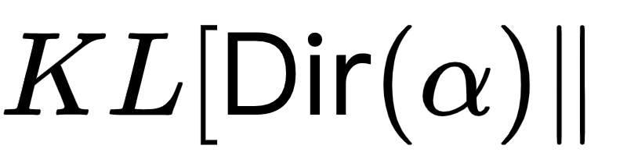
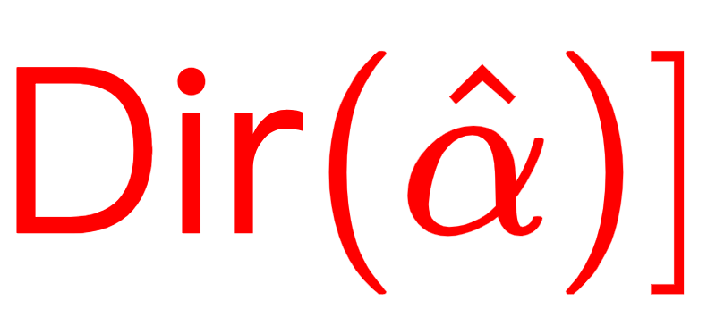
Graph-Based Kernel Dirichlet Estimation
Predict node-level Dirichlet more accurately
Training node
High vacuity occurs when testing node far away from training nodes.
Estimated node
Notes:
To Predict node-level Dirichlet more accurately, we proposed Graph-Based Kernel Dirichlet Estimation (GKDE) ####
We see for each training node, we can give a basic Dirichlet, we can estimate the prior Dirichlet based on raph distance. #######
Then add this KL divergence constrain in our training process, which can give a gureente that:
High vacuity occurs when testing node far away from training nodes.

Slide 7
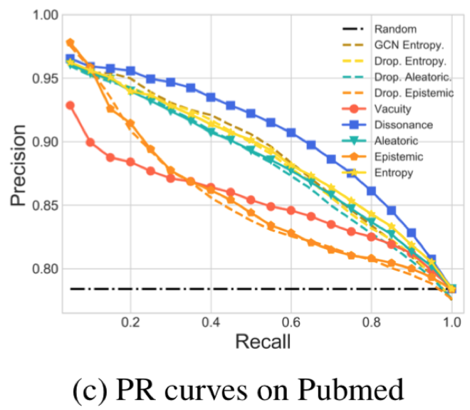
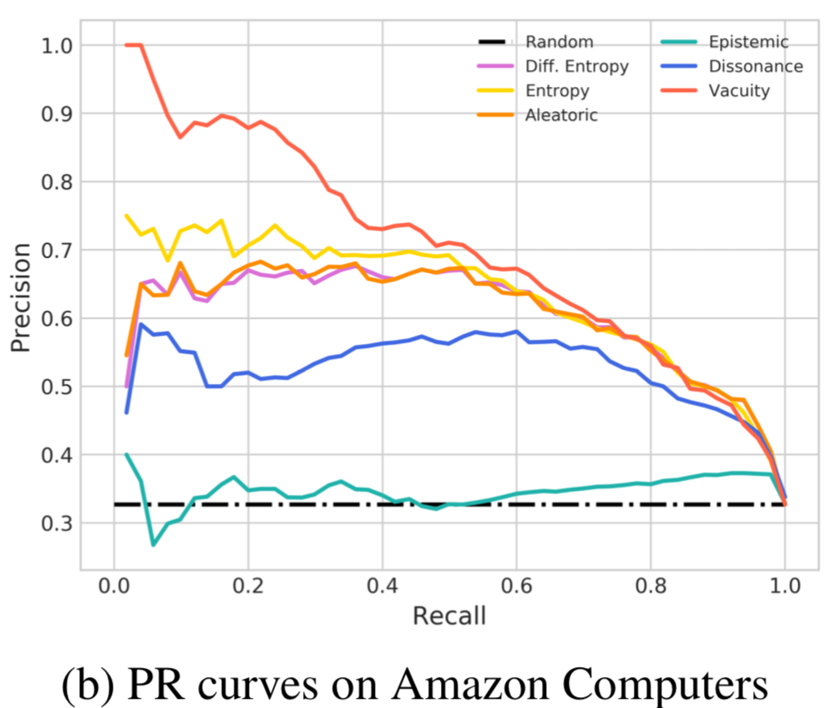
Experiment Result
Misclassification Detection
OOD Detection
Dissonance (Best)
Vacuity (Best)
Misclassification
Correct Prediction
High Uncertainty
Low Uncertainty
Out-of-distribution
In distribution
Notes:
Some experiment results, ####
we found that Dissonance is best in misclassification, ####
and vacuity is best on OOD detection.

Slide 8
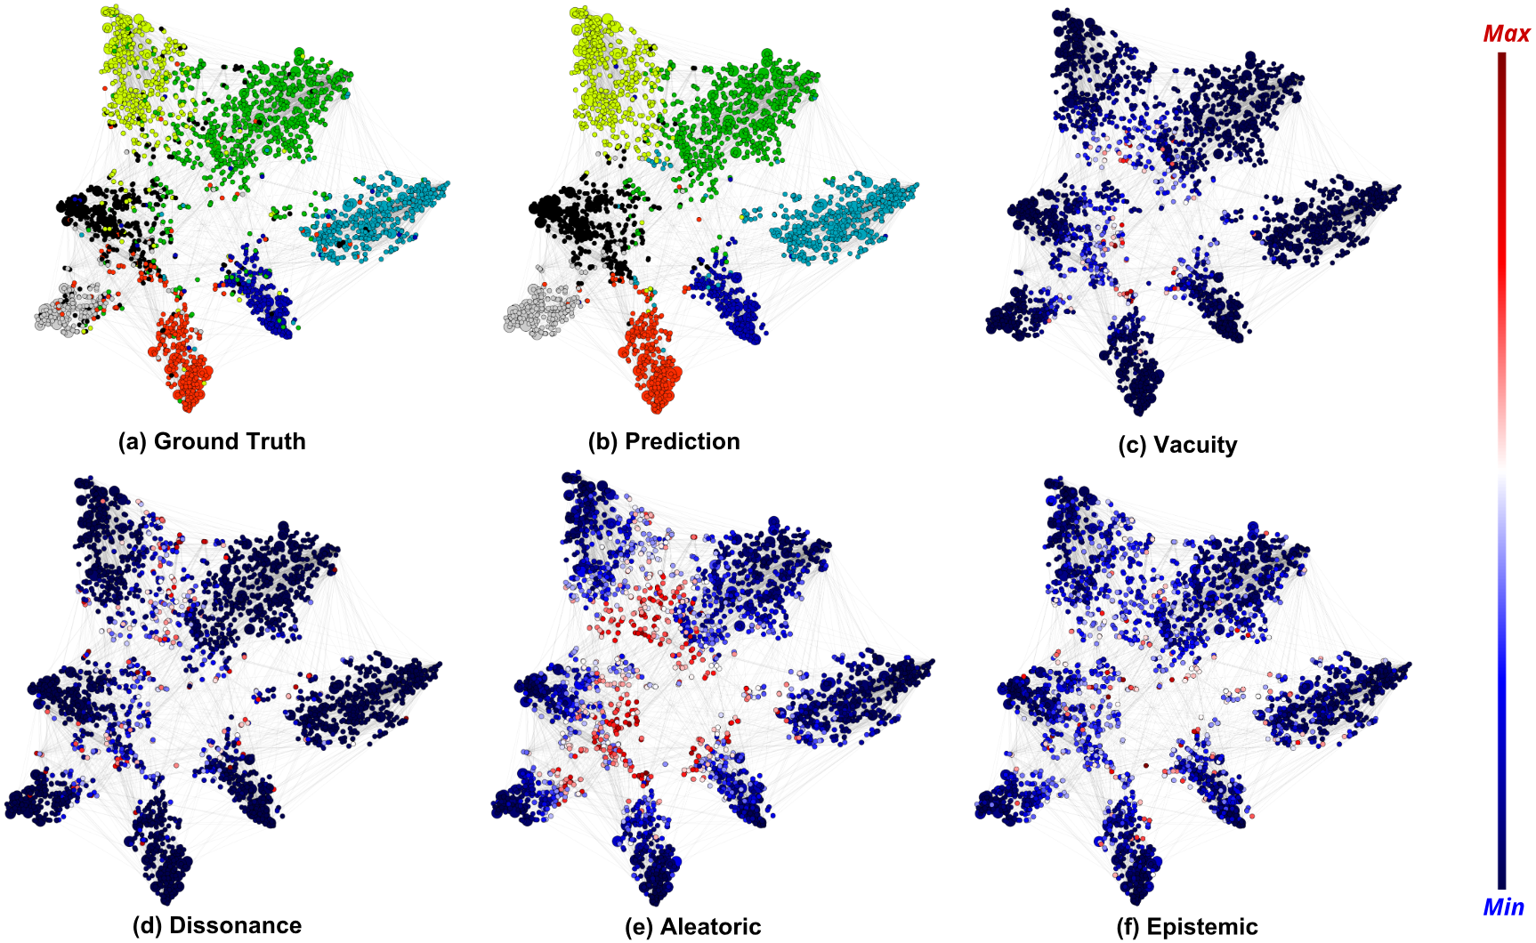
Visualization
Different color represent class label
Red:
High Uncertainty
Blue:
Low Uncertainty
Notes:
Here we show uncertainty visualization.

Slide 9
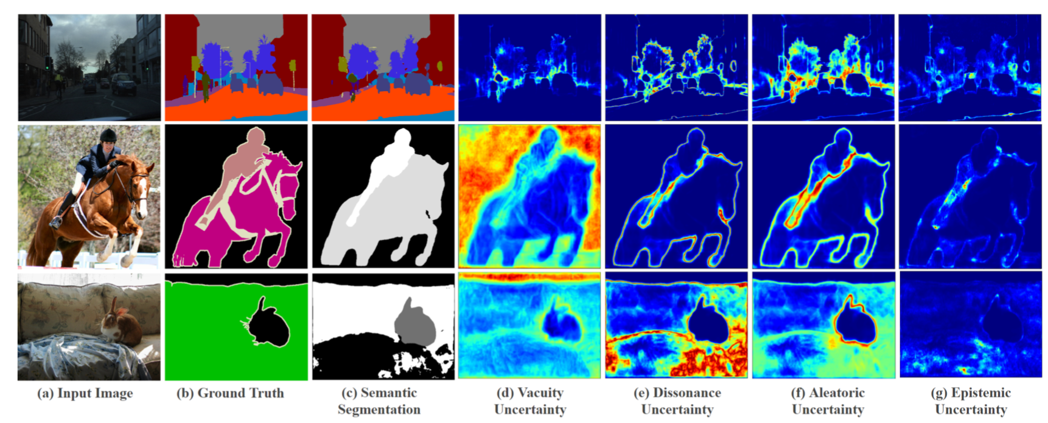
Extension to other Deep Learning Model (CNN)
Replace GKDE to other method to estimation prior Dirichlet Distribution.
Notes:
Our uncertainty can easily extend to CNN model for image segmentation task.

